Slide 1
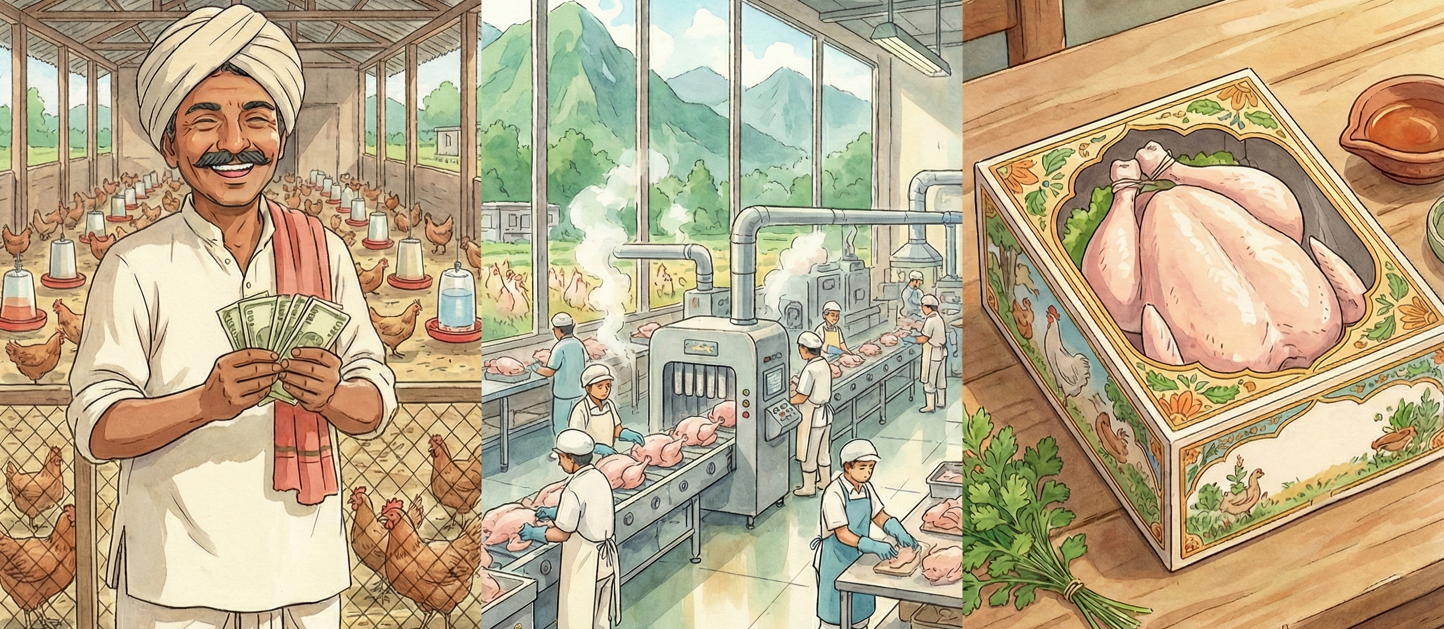


Sustainable & Profitable Poultry Farming for Viksit Bharat
An Outsiders’ Perspective

Slide 2


Slide 3



KEY ASPIRATIONS OF VIKSIT BHARAT
FROM (2024-25)
TO (2047)
Economic Competitiveness
Nominal GDP
$4.13 Trillion
$30 - $35 Trillion
Strong Exports
Agri & Food Processing Exports
~$49 Billion
~$700 Billion
Health & Life Expectancy
Life Expectancy
~71 Years
84 Years
HEALTH & NUTRITION ARE KEY PILLARS FOR SUSTAINABLE GROWTH
Food Security & Rich Nutrition
Notes:
Strategic Pillars for Realizing Viksit Bharat by 2047 - https://www.niti.gov.in/node/1630
Viksit Bharat Targets - https://www.phdcci.in/wp-content/uploads/2024/04/Viksit-Bharat@2047-A-Blueprint-of-Micro-and-Macro-Economic-Dynamics.pdf
Viksit Bharat Targets - https://viksitindia.com/
Exports (2024-25) - https://www.pib.gov.in/PressReleasePage.aspx?PRID=2126119
Life Expectancy - https://www.macrotrends.net/global-metrics/countries/ind/india/life-expectancy
Literacy Rate - https://www.macrotrends.net/global-metrics/countries/ind/india/literacy-rate
Agri & Food Processing Exports - https://www.pib.gov.in/PressReleaseIframePage.aspx?PRID=2170508

Slide 4
PROTEIN IS A KEY DRIVER OF NUTRITION BUT WE HAVE A HUGE PROTEIN DEFICIENCY
WE LAG THE WORLD BY A BIG MARGIN
60-100gm required basis body weight
*Protein Content: Egg – Nutritionx, Chicken/Mutton – TOI, Fish (IMC) –Anuvaad, Milk
Prices – Mumbai wet market benchmarks | https://righttoprotein.com/assets/pdf/Indias-Protein-Paradox-Study.pdf
Notes:
https://www.orfonline.org/expert-speak/indias-protein-deficiency-and-the-need-to-address-the-problem

Slide 5
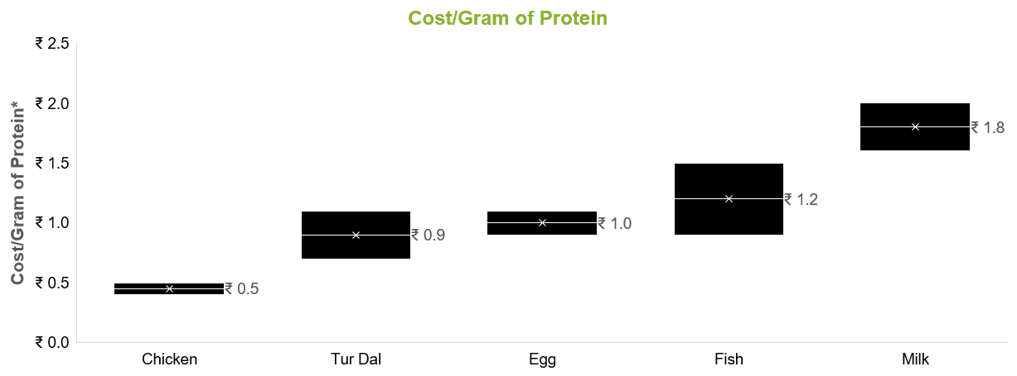
HOWEVER, THE POULTRY SECTOR HAS A VERY COST-EFFECTIVE SOLUTION
MULTIPLE COST-EFFECTIVE & QUALITY SOLUTIONS
*Protein Content: Egg – Nutritionx, Chicken/Mutton – TOI, Fish (IMC) –Anuvaad, Milk
Prices – Mumbai wet market benchmarks | https://righttoprotein.com/assets/pdf/Indias-Protein-Paradox-Study.pdf
Notes:
https://www.orfonline.org/expert-speak/indias-protein-deficiency-and-the-need-to-address-the-problem

Slide 6
WHILE THE POULTRY SECTOR HAS A CRITICAL ROLE TO PLAY, IT IS FAR BEHIND
POULTRY vs FMCG
Contribution to GDP: $50 Billion vs. $220 Billion
Salience
1.2%
5.3%
Exports: $0.1 Billion vs. $5 Billion
Salience
0.01%
0.6%
Value-Addition: < 10% Processing Level vs. 100% Branded
Notes:
Strategic Pillars for Realizing Viksit Bharat by 2047 - https://www.niti.gov.in/node/1630
Viksit Bharat Targets - https://www.phdcci.in/wp-content/uploads/2024/04/Viksit-Bharat@2047-A-Blueprint-of-Micro-and-Macro-Economic-Dynamics.pdf
Viksit Bharat Targets - https://viksitindia.com/
Exports (2024-25) - https://www.pib.gov.in/PressReleasePage.aspx?PRID=2126119
Life Expectancy - https://www.macrotrends.net/global-metrics/countries/ind/india/life-expectancy
Literacy Rate - https://www.macrotrends.net/global-metrics/countries/ind/india/literacy-rate
Agri & Food Processing Exports - https://www.pib.gov.in/PressReleaseIframePage.aspx?PRID=2170508
Poultry contribution to GDP - https://ajmaliasacademy.in/indias-poultry-sector/
Poultry Exports - https://mofpi.gov.in/sites/default/files/KnowledgeCentre/Sector%20Profile/Sector_profile_Meat_Poultry_(1)22.pdf
Fmcg TO gdp: https://www.rightangleglobal.com/post/the-fmcg-industry-in-india-trends-statistics-and-insights#:~:text=The%20FMCG%20industry%20is%20a,Foundation%20and%20India%20Macro%20Indicators.
FMCG Exports - https://www.thehindubusinessline.com/data-stories/data-focus/fmcg-exports-grew-over-15-annually-driven-by-beauty-personal-care-food-beverages/article69984515.ece
https://aims-international.org/aims20/20AProceedings/PDF/A2173-Final.pdf

Slide 7
What’s holding the poultry sector back from CREATING VALUE ?

Slide 8
ARE THERE TOO MANY CONSTRAINTS FOR THE POULTRY SECTOR?

Slide 9
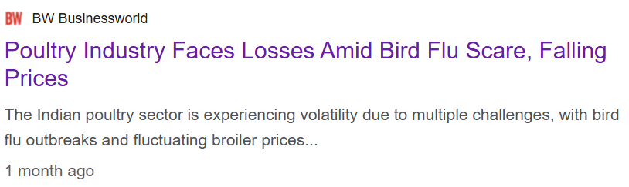

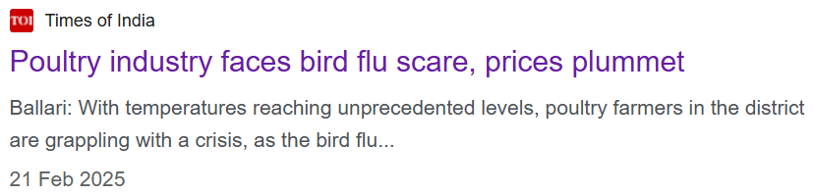
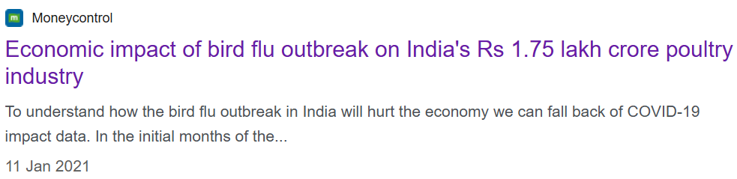
Constraint of foundation: cost volatility
₹15 – 20k Cr losses
Source: https://wahis.woah.org/#/dashboards/qd-dashboard

Slide 10
Constraint of resources: price volatility
Cost: ₹90/kg
Cost: ₹475/100 eggs
Source: GAVL Internal Estimates | NECC
Notes:
1. Egg Prices - https://www.e2necc.com/home/eggprice
2. Egg Cost - https://www.newindianexpress.com/states/tamil-nadu/2025/Jul/25/aadi-cracks-up-egg-price-by-rs-1-in-a-month-namakkal-poultry-sector-faces-heat?ref=finshots.in

Slide 11
EVERY SECTOR HAS ITS UNIQUE CONSTRAINTS
ARE WE THE ONLY SECTOR WHICH FACES SUCH CHALLENGES ?

Slide 12
“We are the stories we tell ourselves”

Slide 13
A Journey into A mega value creation story
in A commodity category

Slide 14


Slide 15
How did parachute create a brand out of a volatile commodity ?

Slide 16
COCONUT OIL IS AS VOLATILE commodity led by global and local dynamics
Source: Coconut Board, Kochi Market Prices

Slide 17
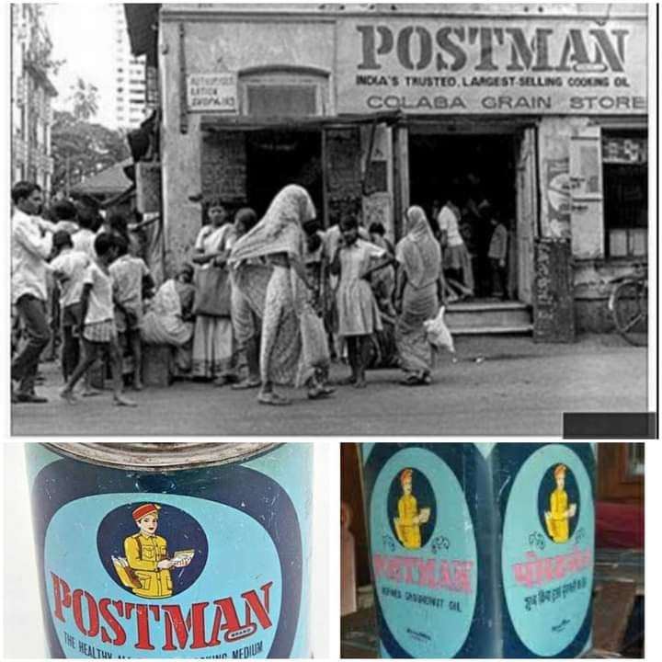
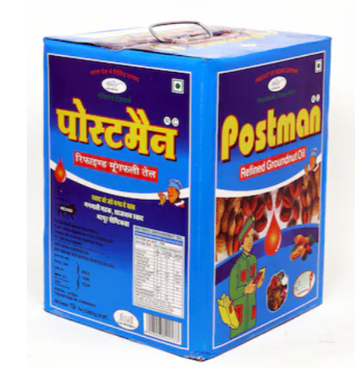
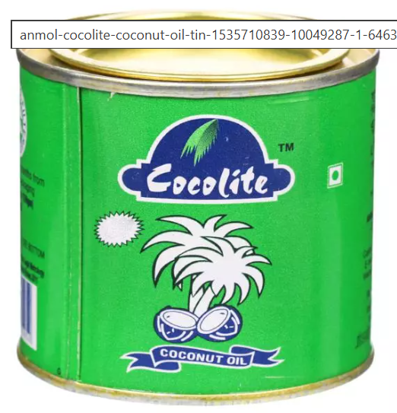
During the 90’s, coconut oil was sold in large tins through oil & soap outlets

Slide 18
MARICO RE-IMAGINED THE COCONUT OIL CATEGORY

Slide 19



1. Product superiority : sourcing CAPABILITY FROM THE BEST in kerala
SOURCED FROM KERALA
WITH CARE TO ENSURE 100% PURITY
Large focus on sourcing to ensure highest quality coconut oil
100% purity from source→ As good as fresh from the tree!
Notes:
Loose - https://marico.com/investorspdf/Marico_Limited_-_Investor_Presentation_-_November_2022.pdf

Slide 20
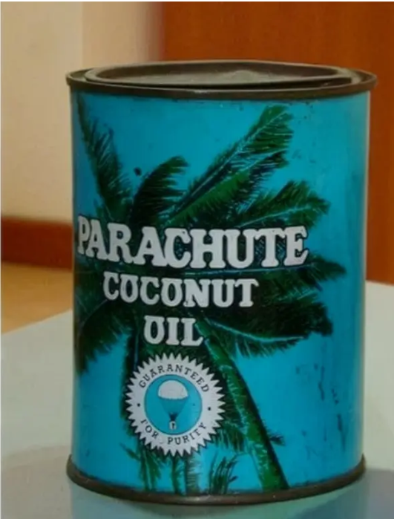
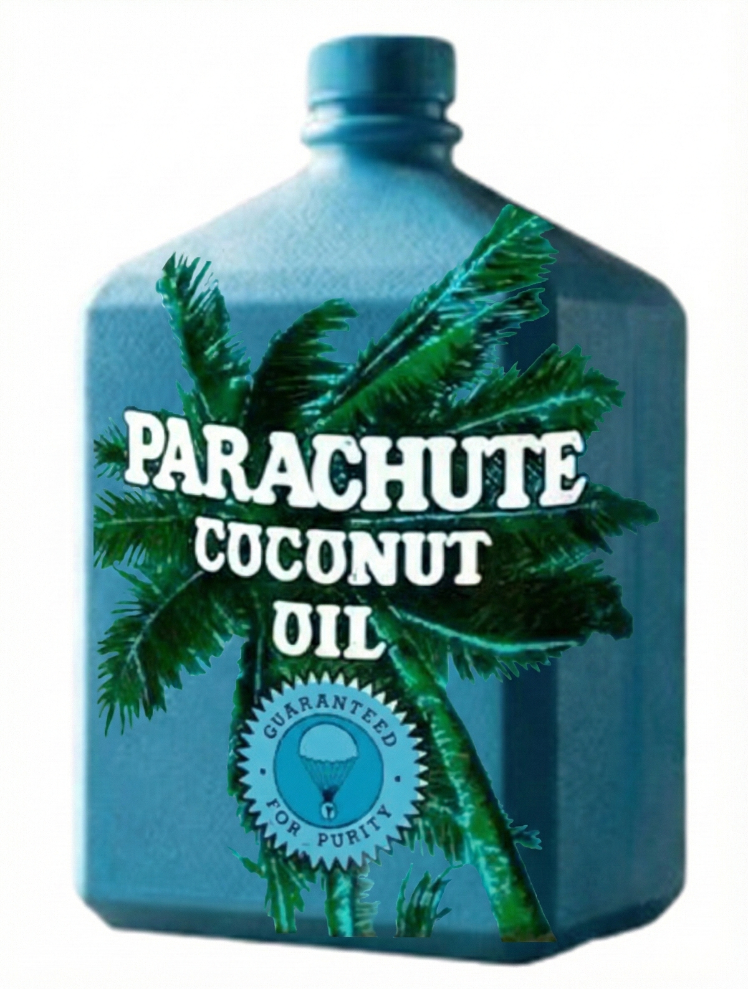

2. DISRUPTIVE packaging INNOVATION that DROVE CONSUMER ADOPTION
New convenient HDPE packs
Better looking, cheaper
but
Rats chewed the edges
Smaller cylindrical bottle
Rats can’t grip the pack
Jump in trials due to smaller and safe packs
Heavy & prone to rust
Notes:
Loose - https://marico.com/investorspdf/Marico_Limited_-_Investor_Presentation_-_November_2022.pdf

Slide 21
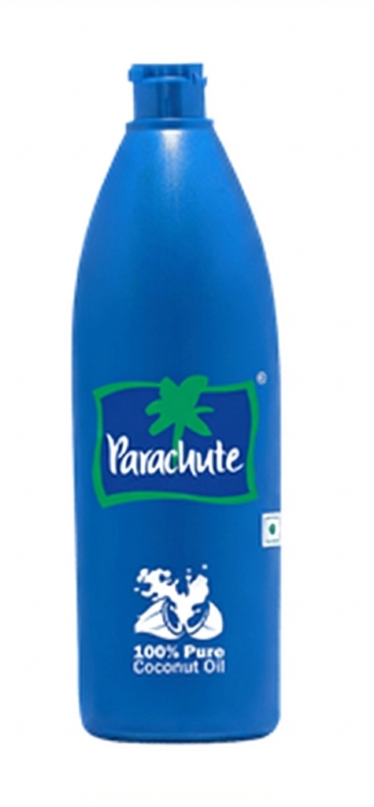
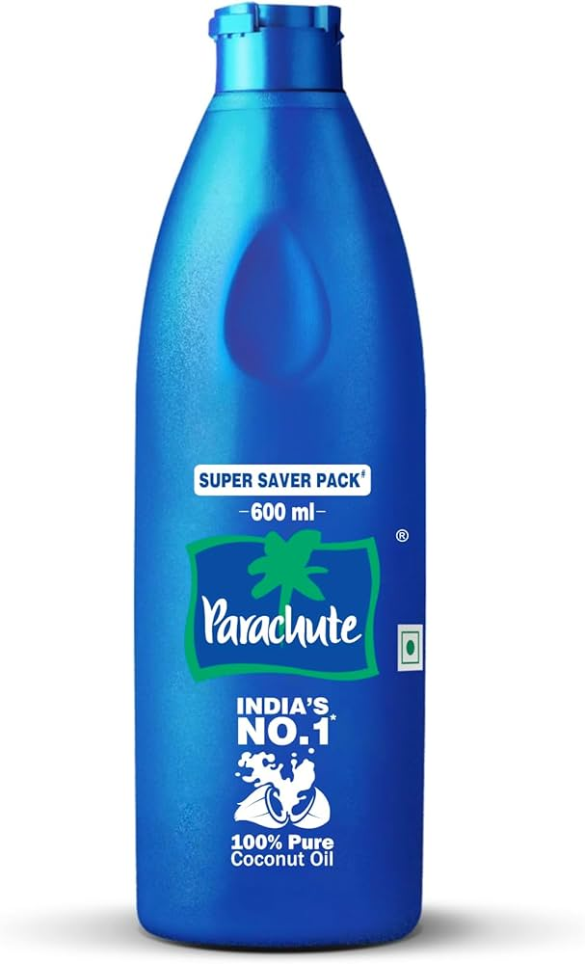
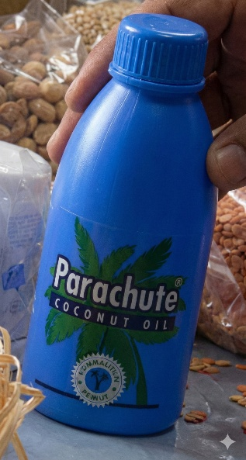
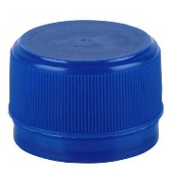
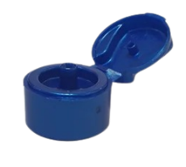
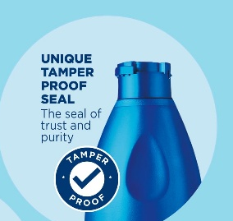
3. New Brand Architecture to cue a premium, differentiated Brand
Premium Bottle with Parachute new Green Tree identity , Flag & Tamper Proof Seal
Drop of Coconut Oil on the Bottle → “Shuddta ka Seal”
Notes:
Loose - https://marico.com/investorspdf/Marico_Limited_-_Investor_Presentation_-_November_2022.pdf

Slide 22


4. FROM NOURISHMENT TO HAIR BENEFITS : vibrant beauty through coconut goodness
Notes:
Loose - https://marico.com/investorspdf/Marico_Limited_-_Investor_Presentation_-_November_2022.pdf

Slide 23
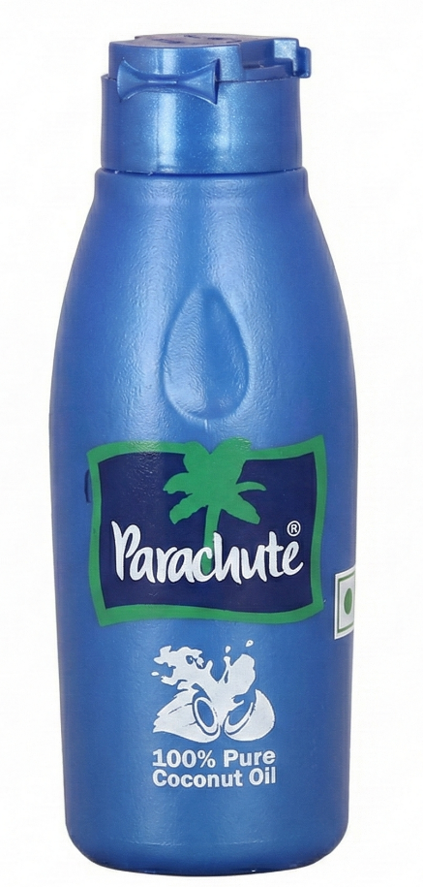

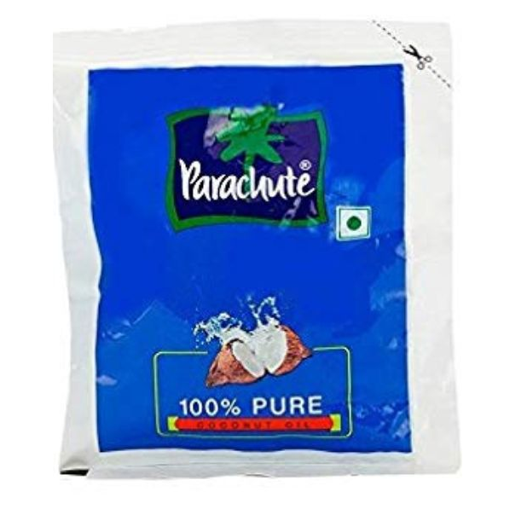
5. Increase penetration across bharat through AFFORDABLE packs
Loose Oil Consumers → Branded Parachute Oil
Introduced sachets and ₹10 bottle to increase conversion in rural areas
Notes:
Loose - https://marico.com/investorspdf/Marico_Limited_-_Investor_Presentation_-_November_2022.pdf

Slide 24
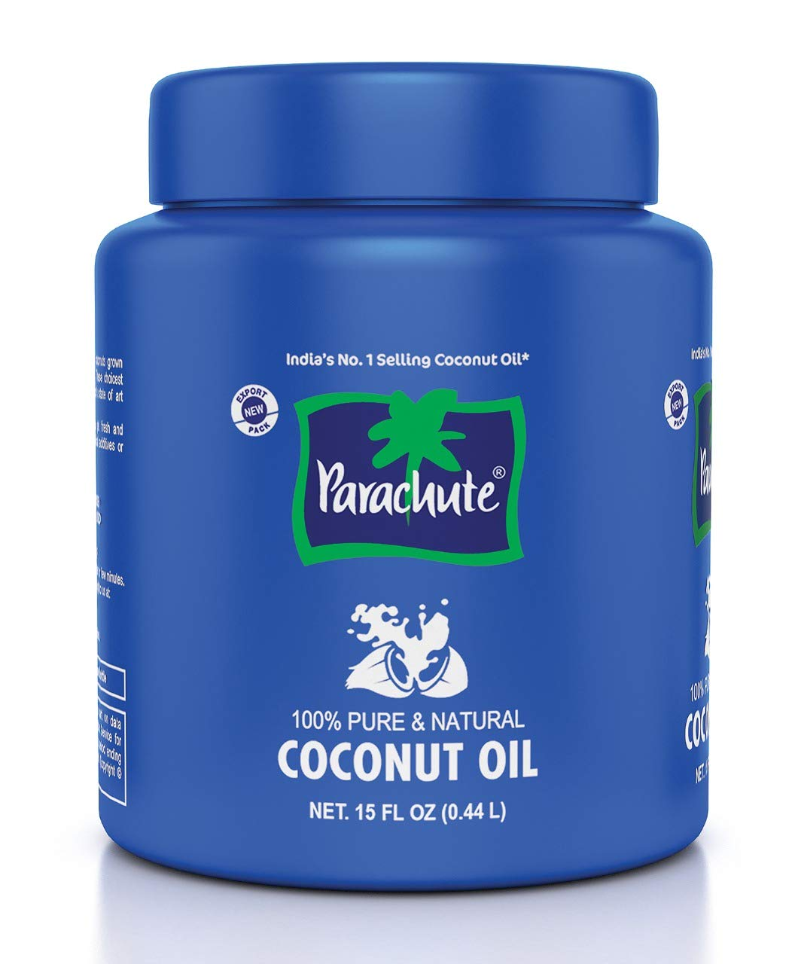

6. Introduced new skus to increase consumption during lean months
EASY JAR “Kamaal Ka Dhakkan”
Wide Mouth Jar → Can use a spoon to scoop out solidified oil
Winter & Monsoon (Lean Season) → Parachute Hot Oil with Warming Ingredients
Notes:
Loose - https://marico.com/investorspdf/Marico_Limited_-_Investor_Presentation_-_November_2022.pdf

Slide 25


7. PREMIUMISATION OF COCONUT OIL THROUGH INTRODUCTION OF MULTIPLE VARIANTS
PARACHUTE JASMINE
PARACHUTE ALOE VERA
Notes:
Loose - https://marico.com/investorspdf/Marico_Limited_-_Investor_Presentation_-_November_2022.pdf

Slide 26
Parachute is the only player with a distribution reach of 5 LAC + Commands a ~55% market share Operates at a premium price index of 120+

Slide 27


PRINCIPLES OF VALUE CREATION
THINK CONSUMER INSIGHTS FIRST
Create Value for the Consumer
INNOVATE FOR THE CONSUMER
INVEST IN CATEGORY DEVELOPMENT → CREATE A BRAND
LEARN FAST FROM ON-GROUND INSIGHTS & COURSE CORRECT
Create Value for the Brand
STAY THE COURSE
Notes:
Strategic Pillars for Realizing Viksit Bharat by 2047 - https://www.niti.gov.in/node/1630
Viksit Bharat Targets - https://www.phdcci.in/wp-content/uploads/2024/04/Viksit-Bharat@2047-A-Blueprint-of-Micro-and-Macro-Economic-Dynamics.pdf
Viksit Bharat Targets - https://viksitindia.com/
Exports (2024-25) - https://www.pib.gov.in/PressReleasePage.aspx?PRID=2126119
Life Expectancy - https://www.macrotrends.net/global-metrics/countries/ind/india/life-expectancy
Literacy Rate - https://www.macrotrends.net/global-metrics/countries/ind/india/literacy-rate
Agri & Food Processing Exports - https://www.pib.gov.in/PressReleaseIframePage.aspx?PRID=2170508
Poultry contribution to GDP - https://ajmaliasacademy.in/indias-poultry-sector/
Poultry Exports - https://mofpi.gov.in/sites/default/files/KnowledgeCentre/Sector%20Profile/Sector_profile_Meat_Poultry_(1)22.pdf
Fmcg TO gdp: https://www.rightangleglobal.com/post/the-fmcg-industry-in-india-trends-statistics-and-insights#:~:text=The%20FMCG%20industry%20is%20a,Foundation%20and%20India%20Macro%20Indicators.
FMCG Exports - https://www.thehindubusinessline.com/data-stories/data-focus/fmcg-exports-grew-over-15-annually-driven-by-beauty-personal-care-food-beverages/article69984515.ece
https://aims-international.org/aims20/20AProceedings/PDF/A2173-Final.pdf

Slide 28
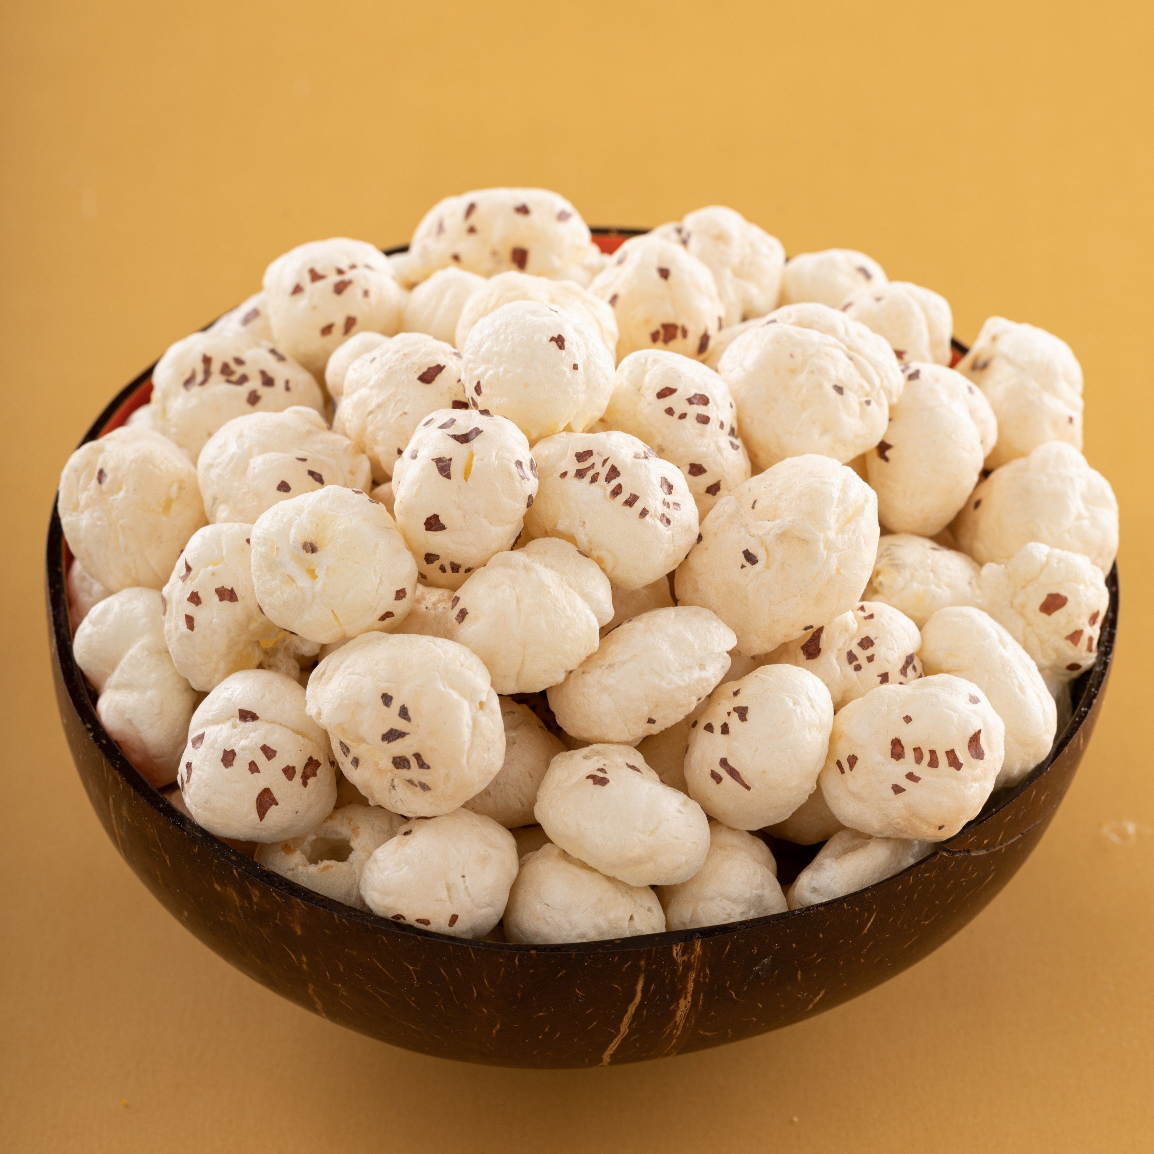
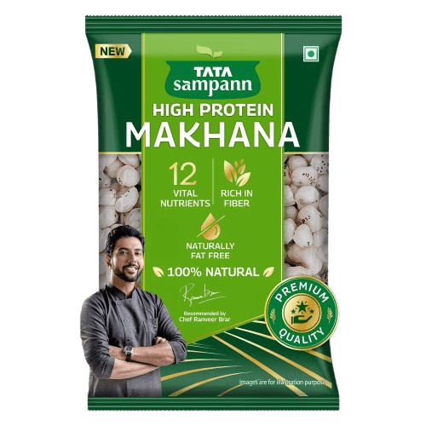
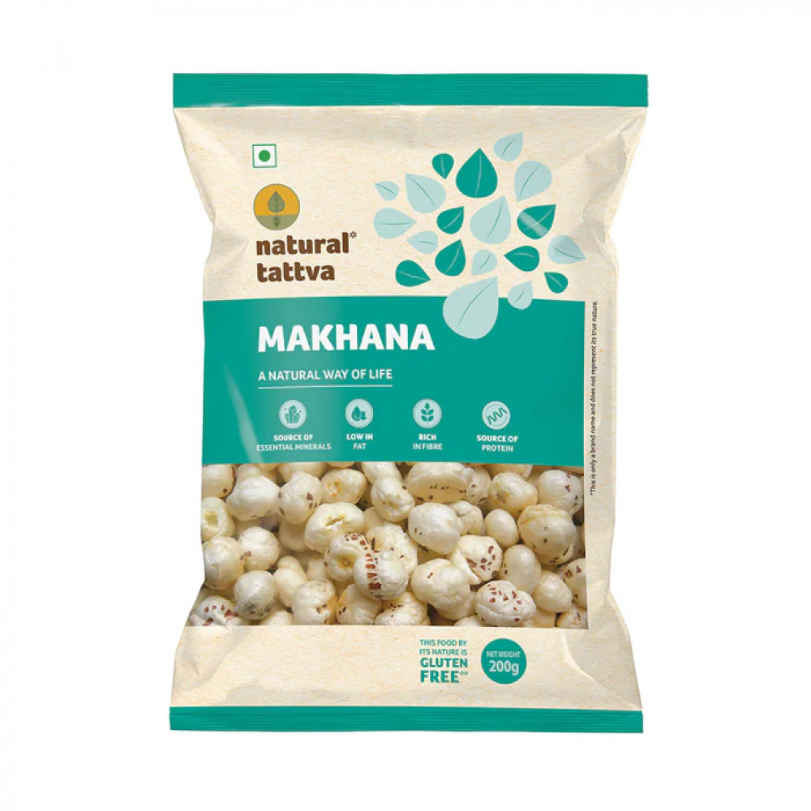
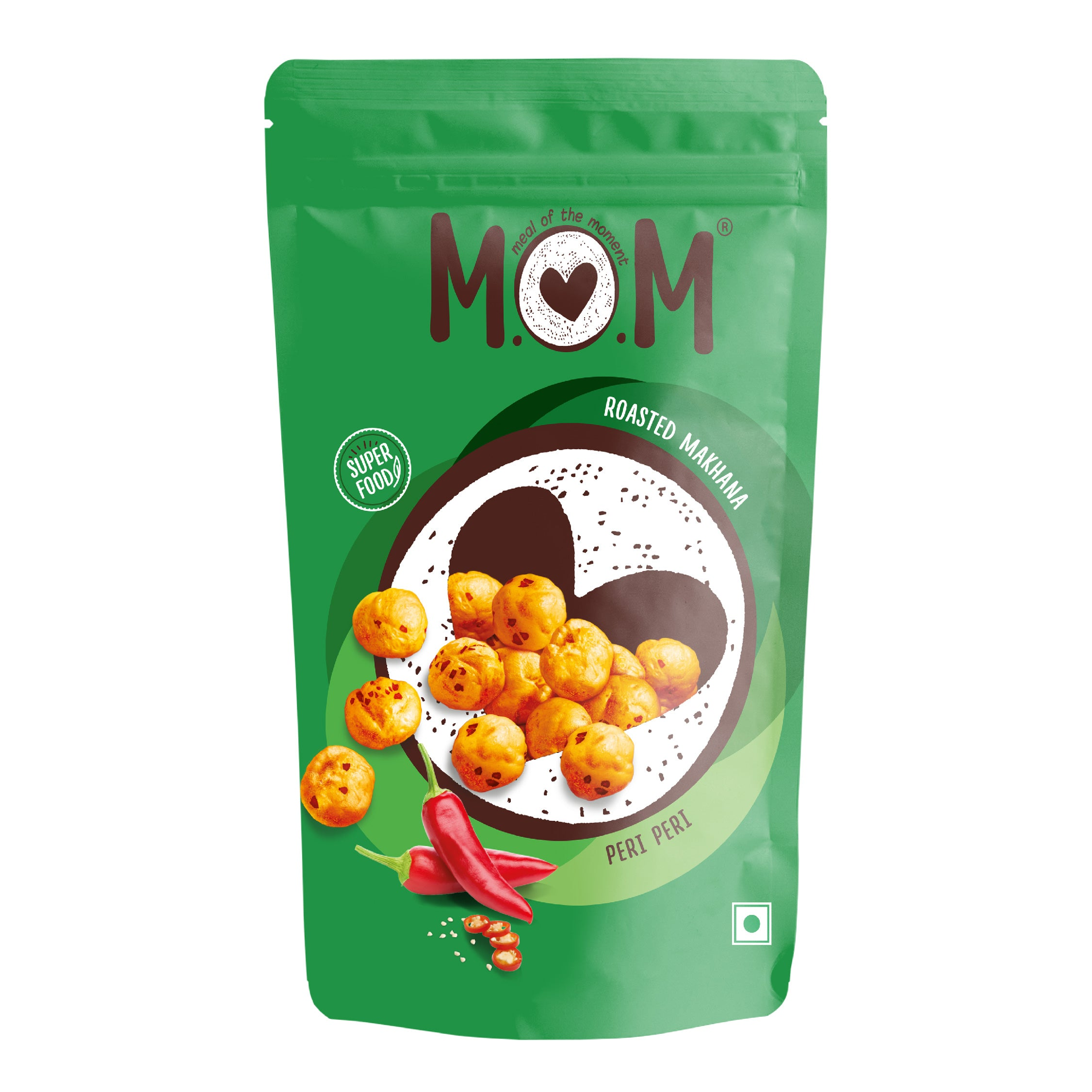
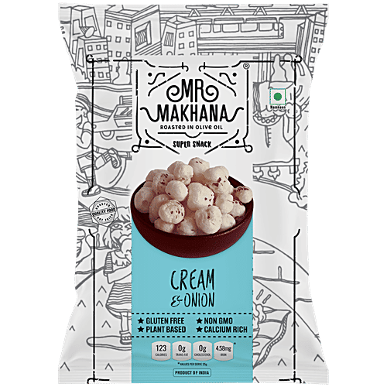
ANOTHER STORY SEEMS TO BE IN THE MAKING ALREADY ….. MAKHANA: BASIC COMMODITY TO GLOBAL SUPERFOOD??
Notes:
Strategic Pillars for Realizing Viksit Bharat by 2047 - https://www.niti.gov.in/node/1630
Viksit Bharat Targets - https://www.phdcci.in/wp-content/uploads/2024/04/Viksit-Bharat@2047-A-Blueprint-of-Micro-and-Macro-Economic-Dynamics.pdf
Viksit Bharat Targets - https://viksitindia.com/
Exports (2024-25) - https://www.pib.gov.in/PressReleasePage.aspx?PRID=2126119
Life Expectancy - https://www.macrotrends.net/global-metrics/countries/ind/india/life-expectancy
Literacy Rate - https://www.macrotrends.net/global-metrics/countries/ind/india/literacy-rate
Agri & Food Processing Exports - https://www.pib.gov.in/PressReleaseIframePage.aspx?PRID=2170508
Poultry contribution to GDP - https://ajmaliasacademy.in/indias-poultry-sector/
Poultry Exports - https://mofpi.gov.in/sites/default/files/KnowledgeCentre/Sector%20Profile/Sector_profile_Meat_Poultry_(1)22.pdf
Fmcg TO gdp: https://www.rightangleglobal.com/post/the-fmcg-industry-in-india-trends-statistics-and-insights#:~:text=The%20FMCG%20industry%20is%20a,Foundation%20and%20India%20Macro%20Indicators.
FMCG Exports - https://www.thehindubusinessline.com/data-stories/data-focus/fmcg-exports-grew-over-15-annually-driven-by-beauty-personal-care-food-beverages/article69984515.ece
https://aims-international.org/aims20/20AProceedings/PDF/A2173-Final.pdf

Slide 29
IT's time for OUR bird to become A brand

Slide 30
THANK YOU

